Slide 1
.Net Architecture

Slide 2
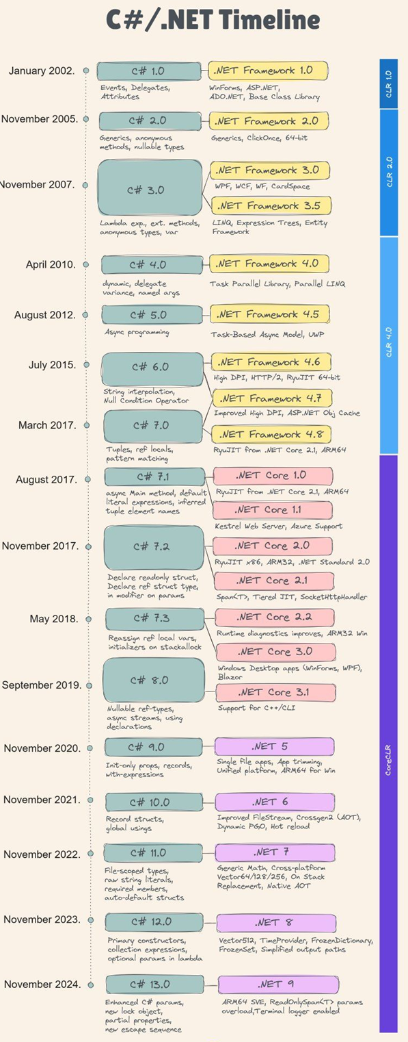

Slide 3
Microsoft released C# 13 in November last year. During its 20+ years, C# has evolved through 13 versions, each with new features. Here is a brief overview of those features: 🔹 𝗖# 𝟭.𝟬 (.NET 1.0, 2002): First release 🔹 𝗖# 𝟭.𝟮 (.NET 1.1, 2003): IDisposable for IEnumerators 🔹 𝗖# 𝟮.𝟬 (.NET 2.0, 2005): Generics, nullable types, iterators 🔹 𝗖# 𝟯.𝟬 (.NET 3.5, 2007): Lambda expressions, LINQ, extension methods 🔹 𝗖# 𝟰.𝟬 (.NET 4, 2010): Dynamic binding, named arguments, optional parameters 🔹 𝗖# 𝟱.𝟬 (.NET 4.5, 2012): Async/await programming, caller info attributes 🔹 𝗖# 𝟲.𝟬 (.NET 4.6, 2015): Auto-property initializers, static imports, exception filters 🔹 𝗖# 𝟳.𝟬 (.NET 4.7, 2017): Tuples, pattern matching, ref locals/returns 🔹 𝗖# 𝟳.𝟭 (2017): Async main, tuple inference, default expressions 🔹 𝗖# 𝟳.𝟮 (2017): Private protected access, Span<T> 🔹 𝗖# 𝟳.𝟯 (2018): New generic constraints, ref reassignment 🔹 𝗖# 𝟴.𝟬 (.NET Core 3.0, 2019): Nullable reference types, indices/ranges, using declarations 🔹 𝗖# 𝟵.𝟬 (.NET 5.0, 2020): Records, init properties, top-level programs 🔹 𝗖# 𝟭𝟬.𝟬 (.NET 6.0, 2021): Record structs, global usings, file namespaces 🔹 𝗖# 𝟭𝟭.𝟬 (.NET 7.0, 2022): Generic math, required members, raw string literals 🔹 𝗖# 𝟭𝟮.𝟬 (.NET 8.0, 2023): Collection expressions, primary constructors 🔹 𝗖# 𝟭𝟯.𝟬 (.NET 9.0, 2024): Enhanced params, partial properties, new lock object

Slide 4
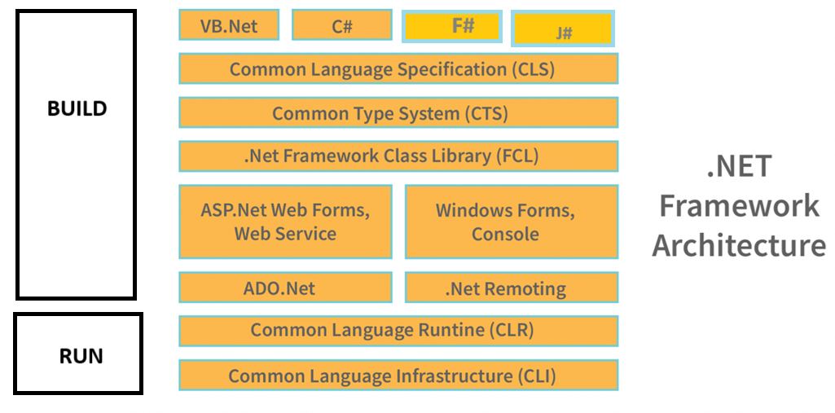
.Net Framework
JIT

Slide 5
Common Language Specification
The Common Language Specification (CLS) is a set of rules and guidelines that .NET languages must follow to ensure interoperability. It allows different languages (like C#, VB.NET, and F#) to work seamlessly within the .NET framework.
Key Features of CLS
✔ Language Interoperability – Code written in one .NET language can be used in another.
✔ Standardization – Ensures that all .NET languages follow a common set of rules.
✔ Cross-Language Inheritance – Allows classes in one language to be extended in another.
✔ Restricts Uncommon Features
CLS Compiant code : This class follows CLS rules since: It uses only CLS-compliant types (like string and int). It does not use unsigned types (uint), which may not be available in some languages.
public class CLSCompliantExample
{
public void PrintMessage(string message)
{
Console.WriteLine(message);
}
}
Marking a Class as CLS-Compliant : You can explicitly declare CLS compliance using the [CLSCompliant(true)] attribute
[CLSCompliant(true)]
public class MyClass
{
public void PrintNumber(int num) {} // CLS-compliant
public void PrintUnsigned(uint num) {} // ❌ Not CLS-compliant (unsigned integers)
}
Ensures cross-language compatibility within .NET.
Prevents non-standard features that cause portability issues.
Encourages best practices that are widely supported

Slide 6
Common Type System
The Common Type System (CTS) is a fundamental part of the .NET framework that defines a set of data types that all .NET languages must adhere to. It ensures language interoperability, meaning different programming languages in .NET (such as C#, VB.NET, and F#) can seamlessly communicate and work together.
Key Features of CLS
✔ Standardized Data Types – Provides a uniform type system across .NET languages.
✔ Ensures Type Safety – Prevents type conflicts between different languages.
✔ Supports Object-Oriented Principles – Includes classes, interfaces, structures, and enumerations.
✔ Enables Cross-Language Integration – C# code can interact with VB.NET or F# without type incompatibility issues.
Classification of Types in CTS
CTS categorizes types into two broad categories:
Value Types (Stored in Stack)
Directly contains data, fast to access
Examples: int, float, bool, char, struct, enum
Reference Types (Stored in Heap)
Stores a reference to the data, supports dynamic allocation
Examples: class, string, interface, array, delegate
Benefits
Ensures consistency in type usage across different languages in .NET.
Improves interoperability, making cross-language programming seamless.
Prevents type mismatches, ensuring safer and more reliable applications.

Slide 7
Framework Class Library
The Framework Class Library (FCL) is a collection of reusable classes, data types, and methods that provide essential functionality for .NET applications. It serves as the foundation for application development in .NET by offering built-in tools for file handling, collections, threading, security, database access, and more.
Key Features of FCL
✔ Prebuilt Functionality – Saves development time by providing ready-to-use classes.
✔ Object-Oriented Design – Supports modular and reusable components.
✔ Cross-Platform Support – Works across Windows, Linux, and macOS with .NET Core/.NET 5+.
✔ Robust Security and Performance – Includes encryption, authentication, and optimized memory management.
✔ Interoperability – Allows different .NET languages (C#, VB.NET, F#) to use the same base libraries.
Category | Examples
System Namespace | Console, Math, DateTime, Environment
Collections | List<T>, Dictionary<K, V>, Queue<T>, Stack<T>
File Handling | File, StreamReader, StreamWriter, DirectoryInfo
Networking | HttpClient, TcpClient, Socket
Threading | Task, Thread, Async/Await
Security | SecureString, Cryptography.HashAlgorithm
Database Access | SqlConnection, Entity Framework
Reduces development time – No need to write basic functionality from scratch.
Improves maintainability – Modular and reusable components make code easier to manage.
Enhances efficiency – Optimized for performance and security.

Slide 8
Common Language Runtime
The Common Language Runtime (CLR) is the core runtime environment of .NET that executes managed code. It provides essential services such as memory management, security, exception handling, and garbage collection.
Key Functions of CLR
✔ Memory Management – Allocates and deallocates memory automatically, preventing memory leaks.
✔ Garbage Collection – Cleans up unused objects in memory to improve performance.
✔ Security Handling – Provides code access security and type safety.
✔ Exception Handling – Ensures consistent error handling across .NET applications.
✔ Thread Management – Handles multithreading to allow parallel execution.
✔ Interoperability – Supports interaction with unmanaged code (like C++ DLLs).
How CLR Works
Compilation – C# code is compiled into Intermediate Language (IL) code.
Execution via JIT Compiler – Just-In-Time (JIT) Compiler converts IL into machine code.
Managed Code Execution – CLR provides security, memory management, and debugging.
C# Code ➝ Compiler ➝ Intermediate Language (IL) ➝ JIT Compilation ➝ Machine Code ➝ Execution
Automatic Memory Management – No need for manual allocation/deallocation.
Improves Application Stability – Handles exceptions uniformly across .NET.
Cross-Language Support – Enables multiple languages to run on the same runtime.
Enhances Performance – JIT optimizes code execution for better efficiency.

Slide 9

Common Language Infrastructure
✔ Multiple Language Support – Allows C#, VB.NET, F#, and others to run on the same platform.
✔ Compilation to IL – Source code is compiled into Intermediate Language (IL), making it language-agnostic.
✔ Execution on CLR – The IL code is executed by the Common Language Runtime (CLR), ensuring consistency

Slide 10
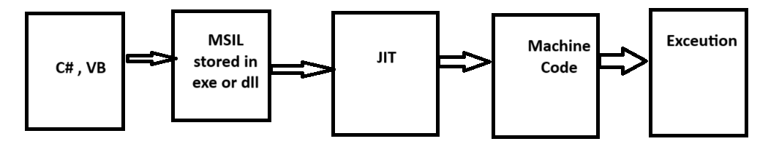
.Net Framework - Code Execution Process

Slide 11
Supported Applications - 1
The .NET Framework is a versatile platform that supports the development of various types of applications across different domains. Here are some of the major applications that can be built using .NET:
1. Web Applications
✔ ASP.NET Web Forms – Ideal for rapid development of web apps using drag-and-drop controls.
✔ ASP.NET MVC – Follows the Model-View-Controller design pattern for scalable and maintainable web apps.
✔ ASP.NET Core – A cross-platform framework for modern web applications and APIs.
2. Desktop Applications
✔ Windows Forms (WinForms) – Used for building rich GUI applications with drag-and-drop features.
✔ WPF (Windows Presentation Foundation) – Supports advanced UI designs with XAML-based layouts.
✔ UWP (Universal Windows Platform) – Enables development of apps for Windows 10 and newer versions.
3. Mobile Applications
✔ Xamarin – Uses .NET to build cross-platform apps for iOS and Android with a shared codebase.
✔ MAUI (.NET Multi-platform App UI) – The successor to Xamarin, designed for mobile and desktop apps.
4. Cloud-Based Applications
✔ Azure-based Applications – .NET integrates well with Microsoft Azure for scalable cloud solutions.
✔ Microservices Architecture – Develop modular applications using ASP.NET Core for cloud environments.
✔ Serverless Computing – Use .NET with Azure Functions to create serverless applications.
5. Gaming Applications
✔ Unity Engine – .NET and C# are widely used in game development with Unity for creating 2D and 3D games.

Slide 12
Supported Applications - 2
6. Enterprise & Business Applications
✔ ERP & CRM Systems – .NET is ideal for building large-scale business solutions.
✔ Financial & Banking Applications – Secure transaction processing using .NET technologies.
7. IoT Applications
✔ .NET for IoT – Supports IoT device programming using .NET Core and Azure IoT services.
8. AI & Machine Learning Applications
✔ ML.NET – A machine learning framework for .NET applications.
✔ Integrations with TensorFlow – Use .NET to call AI models trained in TensorFlow.
9. API Development
✔ RESTful APIs – Develop scalable APIs using ASP.NET Core Web API.
✔ GraphQL APIs – Implement efficient querying using GraphQL with .NET.
10. Database & Data Processing Applications
✔ ADO.NET – Used for database interactions in .NET applications.
✔ Entity Framework (EF Core) – A modern ORM for database access. ✔ Big Data Processing – .NET integrates with Hadoop and Spark for data analytics.

Slide 13
.Net Core - 1
.NET Core is an open-source, cross-platform framework developed by Microsoft for building modern applications. It is a high-performance, modular version of the .NET Framework designed to support Windows, Linux, and macOS.
Key Features of .NET Core
✅ Cross-Platform – Runs on Windows, Linux, and macOS.
✅ Open-Source – Available on GitHub, allowing community contributions.
✅ High Performance – Optimized for speed and efficiency, especially for web APIs and microservices.
✅ Lightweight & Modular – Uses NuGet packages, letting developers include only required components.
✅ Container-Friendly – Works seamlessly with Docker and Kubernetes for cloud deployments.
✅ Modern Development Support – Provides excellent compatibility with ASP.NET Core, EF Core, and Blazor.
Applications Built with .NET Core
✔ Web Apps – ASP.NET Core for building modern, scalable web applications.
✔ Cloud Apps – Optimized for cloud-based services and microservices.
✔ IoT Solutions – Works with connected devices via Azure IoT.
✔ Cross-Platform Desktop Apps – Using .NET MAUI (Multi-platform App UI).
✔ APIs & Microservices – Lightweight API development with ASP.NET Core Web API.
✔ AI & Machine Learning – Supports ML.NET for artificial intelligence solutions
Why Use .NET Core?
✅ Cross-Platform – Develop once, run anywhere.
✅ Fast & Lightweight – Optimized for speed and performance.
✅ Scalable & Cloud-Ready – Ideal for microservices and cloud deployments.
✅ Future-Proof – Supports modern development standards and frameworks.

Slide 14
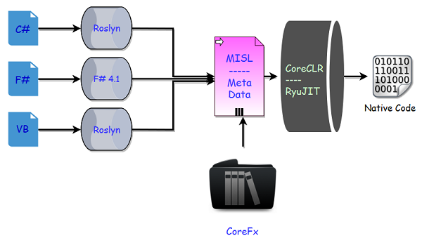
.Net Core - Code Execution Process
In .NET Core now we have a new series of compilers, like we have Roslyn for C# and VB.
You can also make use of the new F# 4.1 compiler if you want to use F# with .NET Core.
We can use Roslyn with .NET Framework as well if we are using C# 6 or later, because C# compiler can only support up to C# 5.
These compilers convert the code to Intermediate language (MSIL)
We also have a new run time with .NET Core known as CoreCLR and leverages a JIT (Just In Time) compiler called RyuJIT. CoreCLR uses JIT to convert MSIL to machine code.

Slide 15
Compiler Recap
Compiler | Language | Description
Roslyn | C# & VB.NET | Open-source compiler providing real-time code analysis & refactoring tools
RyuJIT | JIT Compilation | Converts IL to machine code at runtime for performance optimization
ILC (Ahead-of-Time Compilation) | Native Compilation | Used for .NET Native to compile apps ahead of time
F# Compiler (fsc.exe) | F# | Compiles functional programming code into IL
Mono Compiler and Runtime (.NET Framework) | C# (for Mono runtime) | Alternative runtime for cross-platform applications

Slide 16
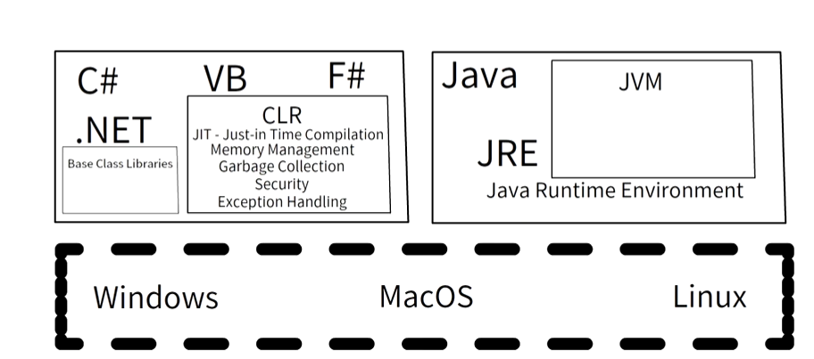
Java Vs .Net

Slide 17
Assembly - 1
In C#, an assembly is a compiled code library used for deployment, versioning, and security in .NET applications. Assemblies can be .exe (executable) or .dll (dynamic link library) files and contain metadata, code, and resources.
Key Features of Assemblies:
Encapsulation: Assemblies bundle related types and resources together.
Versioning: Each assembly has a unique version number for tracking updates.
Security: Assemblies define security boundaries and permissions.
Metadata: The assembly manifest contains details like version, culture, and referenced assemblies.

Slide 18
Assembly -2
An EXE file (short for "executable") is a type of file that contains a program that can be run on a Windows operating system. When you double-click an EXE file, the system executes the instructions within it to launch an application or perform a specific task.
Different Types of EXE Files:
Application EXE – Standard executable files that launch programs (e.g., notepad.exe, chrome.exe).
Installer EXE – Used to install software on a system (e.g., setup.exe, install.exe).
Console EXE – Command-line applications that run in the terminal without a graphical interface.
Self-Extracting EXE – Archives that extract files when executed, often used for compressed software packages.
Malicious EXE – Executables that contain viruses or malware, often disguised as legitimate files.

Slide 19
Assembly -3
A DLL (Dynamic Link Library) is a file that contains code and data that multiple programs can use simultaneously. DLLs help modularize applications, reduce redundancy, and improve efficiency by allowing different programs to share common functionality.
Key Features of DLLs:
Code Reusability: Functions stored in a DLL can be used by multiple applications.
Memory Efficiency: Programs using DLLs consume less memory since they share common resources.
Modular Design: Developers can update or fix a DLL without modifying the entire application.
Security & Versioning: DLLs help maintain software integrity and allow version control.

Slide 20
Assembly -4
A satellite assembly in .NET is a special type of assembly that contains localized resources for different languages and cultures. It allows applications to support multiple languages without modifying the main executable.
Key Features:
Localization Support: Stores translated text, images, and other culture-specific resources.
Separation from Main Assembly: Contains only resources, not executable code.
Efficient Resource Management: The correct assembly is loaded based on the user's language settings.
Example:
If an application has English as the default language but needs to support French and Spanish, separate satellite assemblies (App.resources.dll) are created for each language. The .NET framework automatically loads the appropriate assembly based on the user's locale.

